Slide 1
Databricks Reference Applications for Apache Spark
Arseniy Tashoyan
February 2017

Slide 2
About Arseniy Tashoyan
Software engineer at Hewlett Packard Enterprise
Leader of Integration and Validation Team
Works on
Operation Support Systems for Telco operators
Fault Management solutions
Interested in
Distributed computations
Cloud technologies
Open source contribution

Slide 3
What is Apache Spark
Distributed parallel computation engine
Runs in a cluster of commodity machines
Hadoop YARN
Apache Mesos
Standalone cluster manager (included in Spark)
Fault tolerant
Streaming operations, SQL operations, machine learning, graphs
Supports applications written in Scala, Java, Python, R

Slide 4

How Apache Spark works
Driver Program
main(): business logic
Cluster Manager
Provides computation resources
Worker Node
A machine in the cluster
Executor
Runs tasks
Holds data
Task
Unit of work
http://spark.apache.org/docs/latest/cluster-overview.html

Slide 5
What is Resilient Distributed Dataset (RDD)
In-memory
Distributed across worker nodes
Each partition on its node
Fault tolerant
Can be recomputed to restore lost data
Can be replicated
Each partition has a replica on another node
Can be saved to disk
To a distributed file system

Slide 6
Operations on RDD
Data transformations
Actions
filter
map
union
intersection
join
…
reduce
collect
count
save
…
whatsWrong = logLines.filter(line -> line.isError())
.map(line -> line.getErrorExplanation())
.collect()

Slide 7
Databricks Reference Applications for Spark
Log Analyzer
Basic Spark operations, Spark Streaming
Scala, Java 8
Twitter Language Classifier
MLlib – Spark machine learning
Scala
Weather Time Series
Spark Streaming
Kafka integration, Akka Actors, Cassandra DB
Scala
https://github.com/databricks/reference-apps

Slide 8
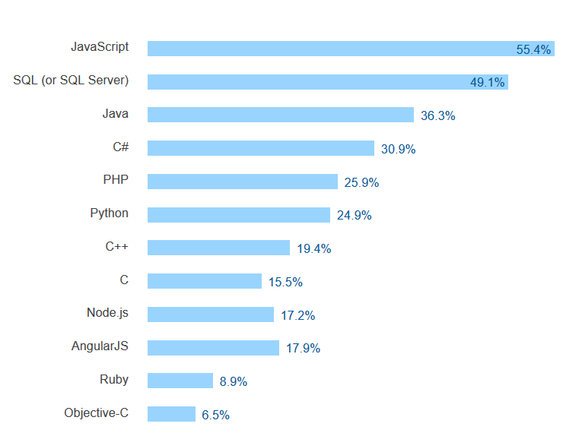
Why Reference Applications in Java?
Stack Overflow survey 2016: Most popular technologies
Where is Scala?
http://stackoverflow.com/research/developer-survey-2016#technology

Slide 9
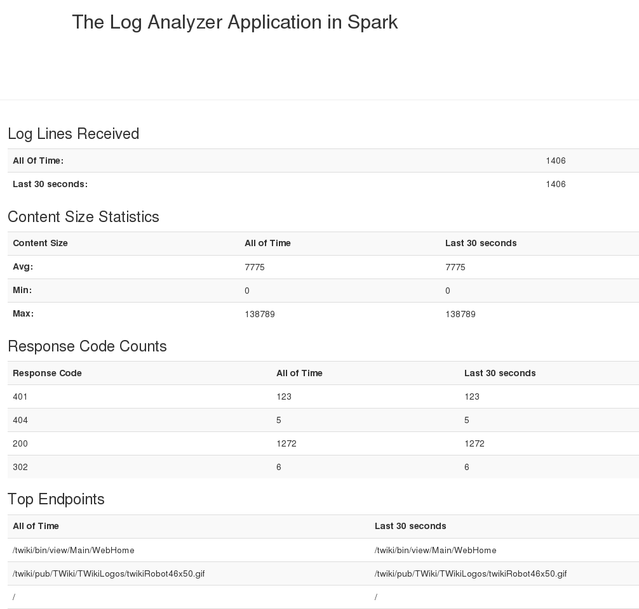
Log Analyzer Structure
Chapters 1-3: Learn basic Spark features
Chapter 4: Apply new knowledge in Log Analyzer Application
Apache web server access statistics

Slide 10
Statistics from Log Analyzer
Statistics on HTTP requests
content size: min / max / average
response code counts
clients accessed the server more than 10 times
top 10 accessed endpoints
Sliding window and total
Real-time input data

Slide 11
Spark features in Log Analyzer
Spark Streaming
Directory polling: textFileStream()
Sliding window calculations: window()
Cumulative state update: updateStateByKey()
Transformations: map(), maptToPair(), filter()
Calculations: reduce() , reduceByKey(), min(), max()

Slide 12
Other Spark features in Chapters 1-3
Spark SQL API
Dataset concept
SQL queries
Spark Streaming API
DRY with foreachRDD() and Java 8 lambdas
Data output to file system
Small data
Large data

Slide 13
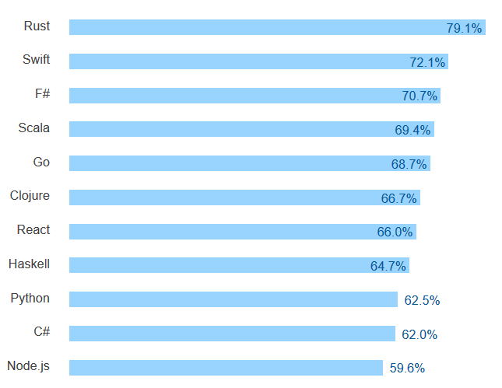
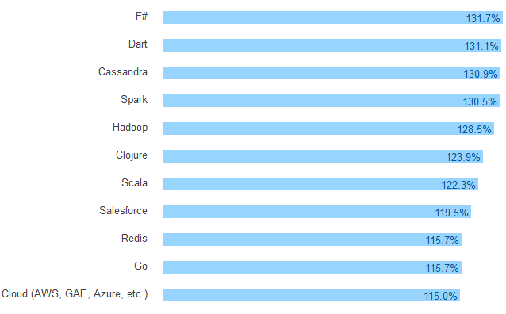
Java Ref Apps: For Java folks’ wealth and joy
Most loved technologies
Top paying technologies
Where is Java?
http://stackoverflow.com/research/developer-survey-2016#technology

Slide 14

Your questions

